Slide 1
Fanex Caching
Prepared by Jason Ly

Slide 2
Agenda
Objectives
Technical view
Sample code

Slide 3
Objectives
Provide an abstract layer for different data storages
Switch between caching library easier
Easy to add new data storage
Currently support three storages:
MemoryCaching
Couchbase
Redis (version 2.8.17)

Slide 4
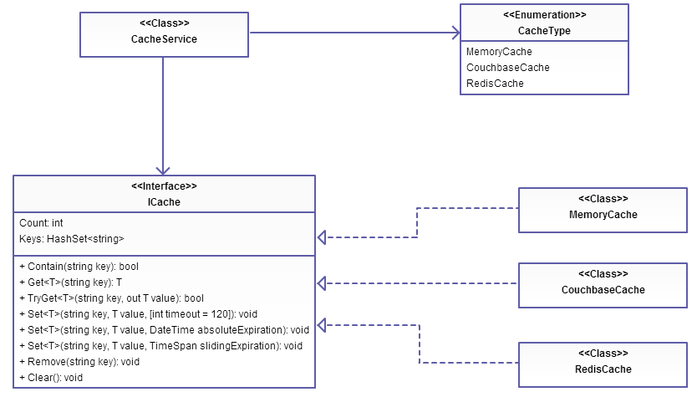
Library Overview

Slide 5
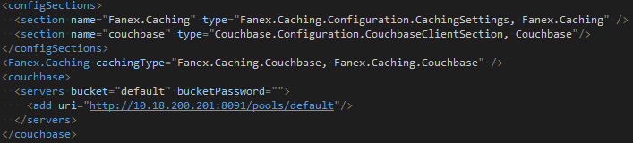
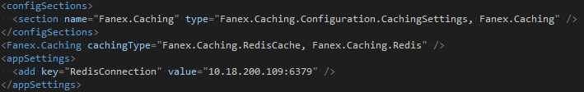
Sample configuration
Configuration for Couchbase
Configuration for Redis

Slide 6
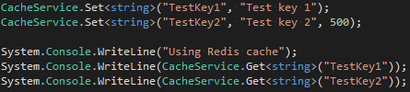
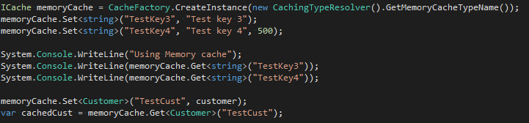
Sample code
Configure Redis as the default caching storage (reference to the previous slide)
Cache values in Redis:
Cache another values in the memory (not the default caching storage):
Cache it for 500s
Create new cache instance
Cache it for 500s

Slide 7
Thank you

